Slide 1
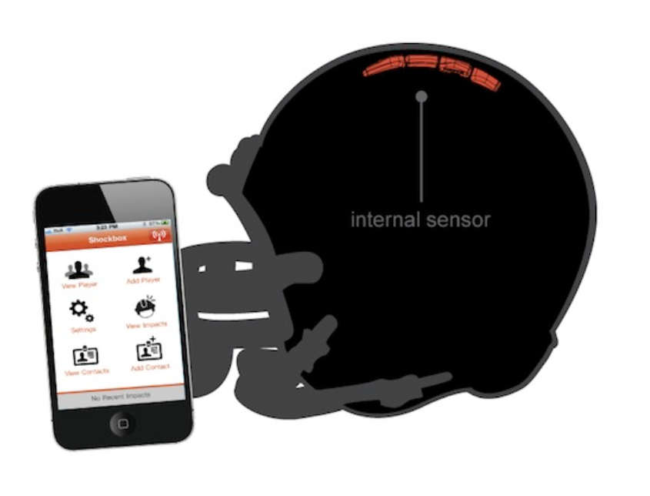
Helmet Integrated Impact
Detection System
(HI-IDS)
Presenter: Calvin Lee
Role: Software Testing

Slide 2
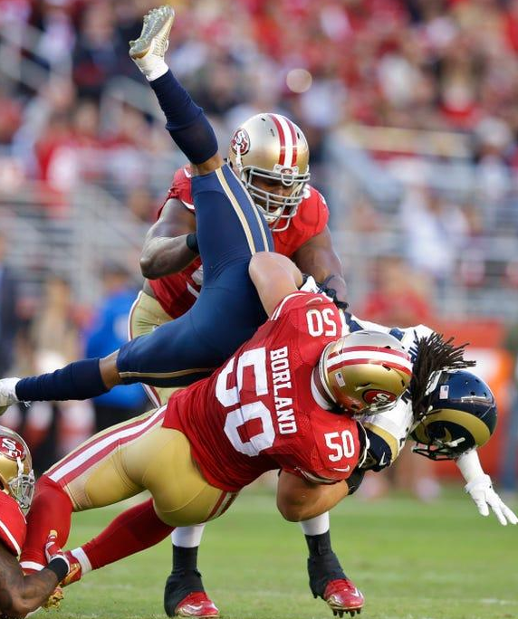
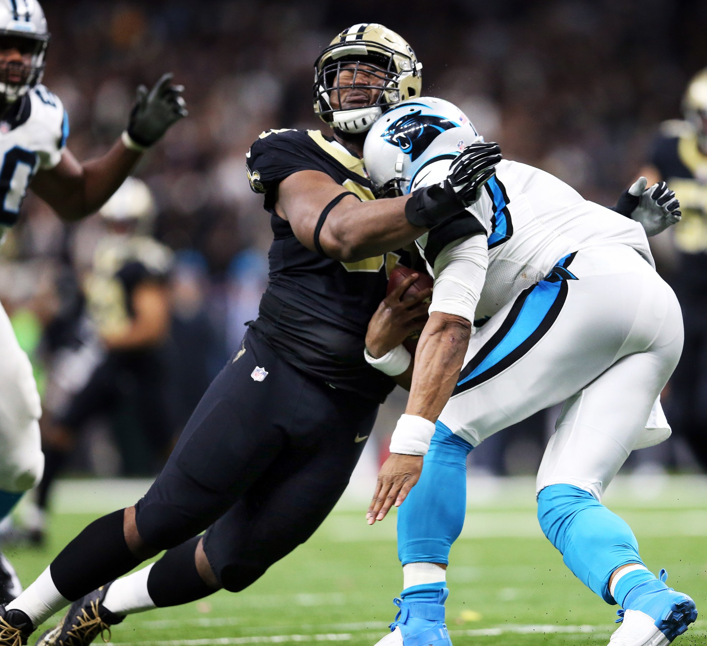
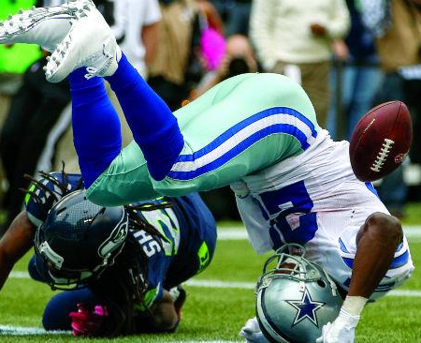
Concussions are a Serious Problem in Football !
Figure 1. NFL players making helmet on helmet contact.

Slide 3

Overview
Team
Technical Objectives, Desired Functionalities, and Use Cases
Key System Requirements
Standards and Safety Summaries
Top-level System Design
Hardware Design and Requirements
Software Design and Requirements
Summary

Slide 4


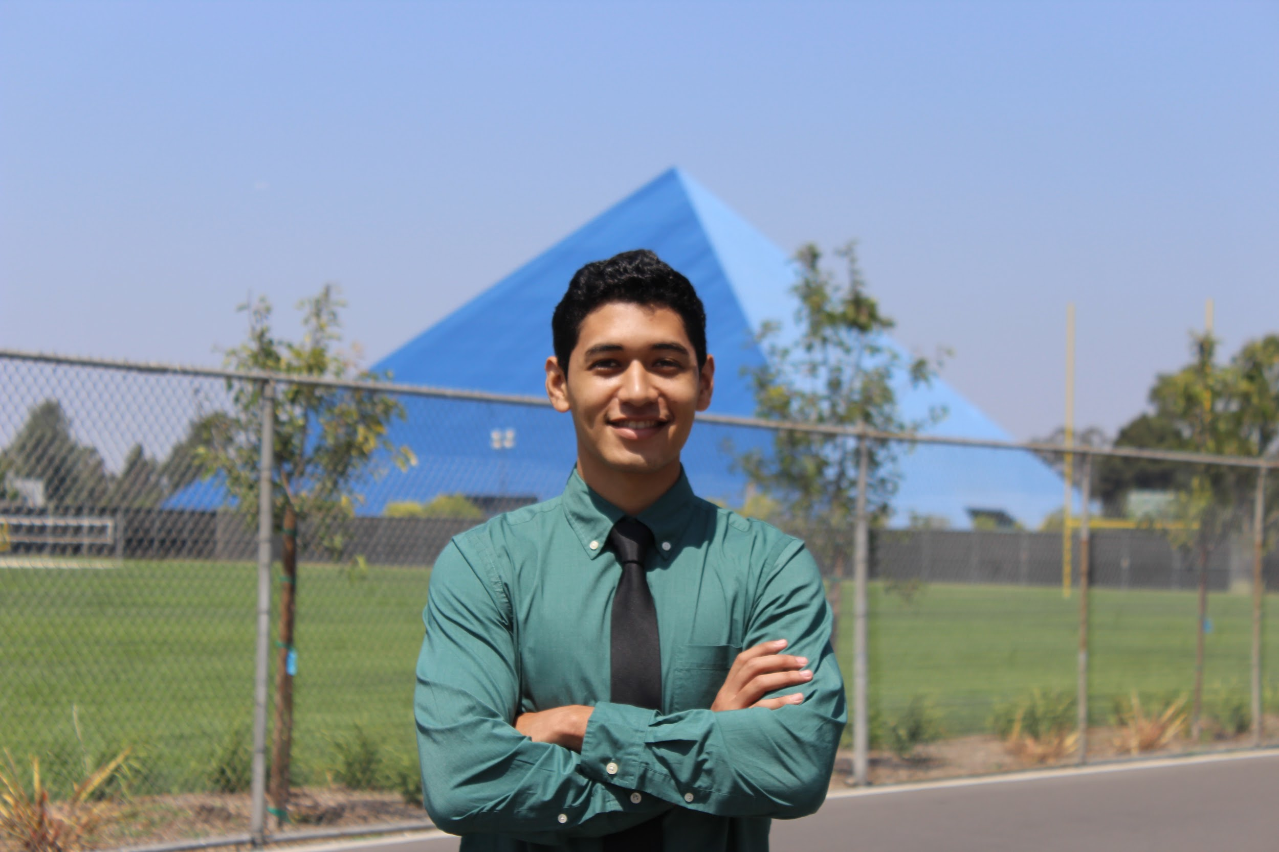

Building a HI-IDS with Qualified Team Members
Jasmine Arrieta
Role: Hardware Design
Emphasis: Electronics
Experience: 3D Printing, Creo, Python, Power Systems
Calvin Lee
Role: Software testing &
development
Emphasis: Communications
Experience: C++ / Python
Rhyan Gonzalez
Role: Hardware Design
Emphasis: Electronics
Experience: C++, VHDL, Matlab
Socheath Sok
Role: Software Design
Emphasis: BME
Experience: MATLAB, Simulink, VHDL, & Assembly

Slide 5
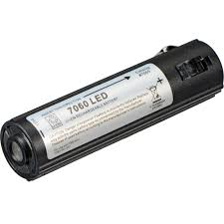
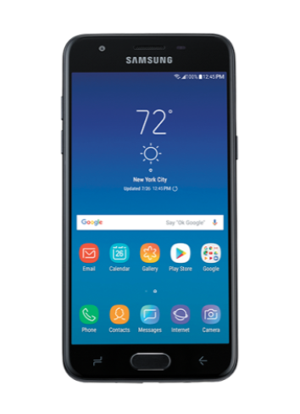
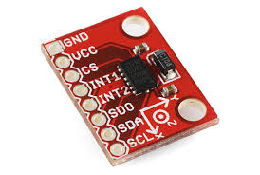

Primary Technical Objectives are Usability and Accuracy
Seamlessly integrate the sensor into the helmet
Measure impacts between +/- 200 G force
Communication range of at least 50 meters
Powered by rechargeable batteries

Slide 6

Desired Functionalities is to Detect Concussions
Measure collisions to the helmet
Transmit the data collected from the helmet wirelessly to an app
Send an alert on the app when a helmet collision exceeds a certain threshold
Display a history of impact data over a selected period of time

Slide 7
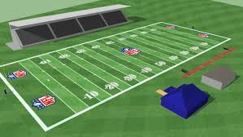
HI-IDS is Suited for Football Players
Helmet:
Football players of any level playing games and practices
App:
Coaches and physicians

Slide 8
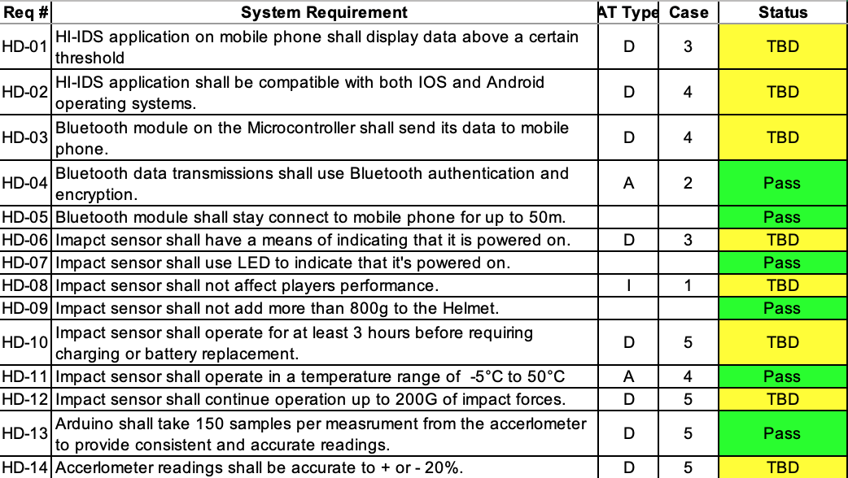
HI-IDS with Important Key System Requirements
Notes:
Bluetooth Connectivity requirements
OS compatibility requirements
Operation requirements ( temperature, G force)
Accuracy requirements (

Slide 9
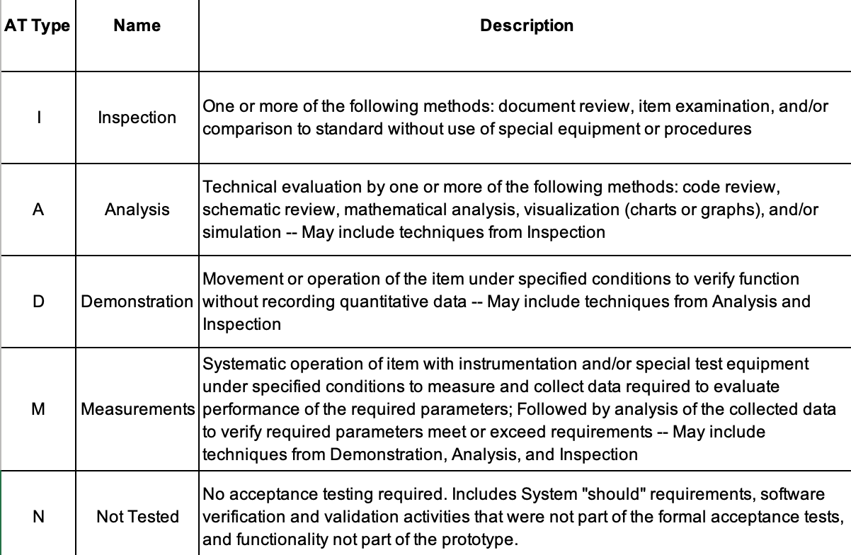
AT Type for our System Requirements

Slide 10
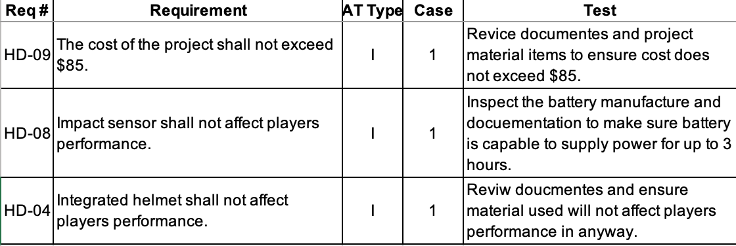
Testing our System Requirements

Slide 11
Summarizing Standards and Safety
IEC 60086-4 Ed. 4.0 b:2014
Primary batteries - Part 4: Safety of lithium batteries
IEEE 802.11b-1999
IEEE Standard for Information Technology - Telecommunications and information exchange between systems - Local and Metropolitan networks - Specific requirements - Part 11: Wireless LAN Medium Access Control (MAC) and Physical Layer (PHY) specifications: Higher Speed Physical Layer (PHY) Extension in the 2.4 GHz band
IEEE 836-2001
IEEE Recommended Practice for Precision Centrifuge Testing of Linear Accelerometers
ISO/IEC 9126-1:2001
Software engineering — Product quality — Part 1: Quality model
UHS-III
UHS-III SD Memory Card Standard
Notes:
Battery standards
Telecommunication standards,
Accelerometers standards,
Product quality standards,
Memory card standards.

Slide 12
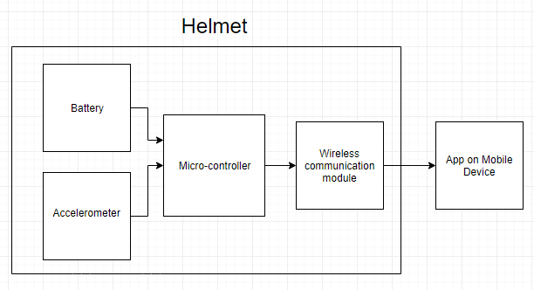
Top-level system Architecture
Wireless Communication Module
C
M
Sensor

Slide 13
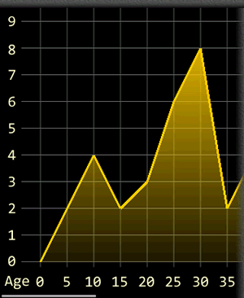

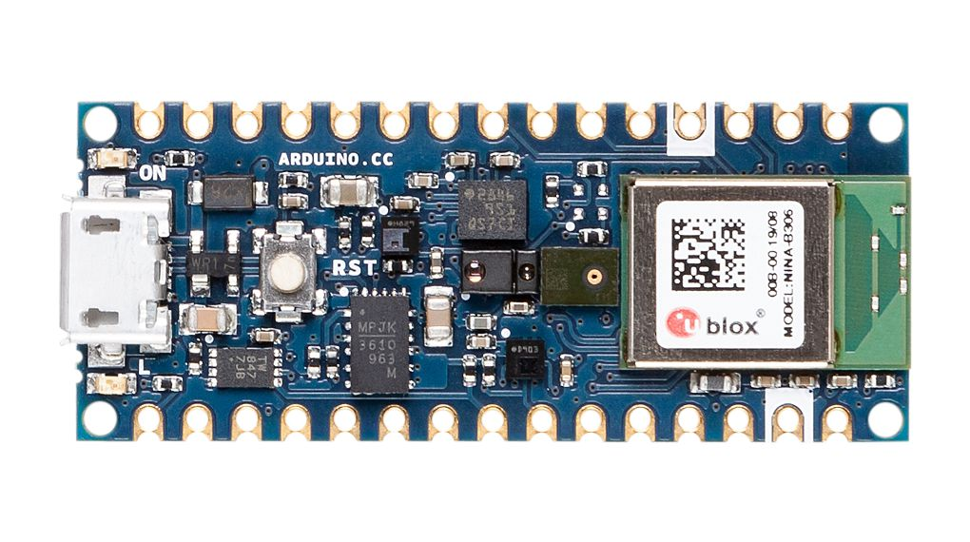
Partitioning The System
Hardware
Software

Slide 14
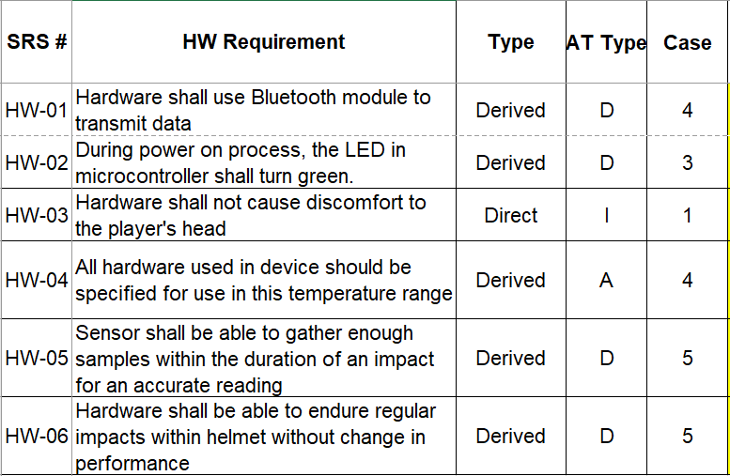
Identifying Hardware Requirements

Slide 15
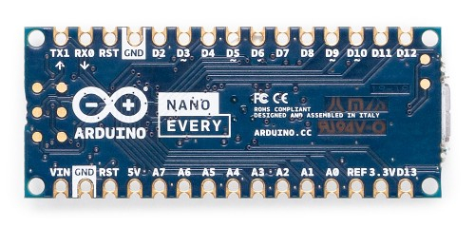
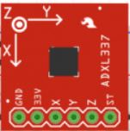
Designing The Hardware Using Arduino and Accelerometer
Accelerometer will measure helmet collisions.
Arduino nano will convert raw data from the accelerometer into g-force, and filter out data below 100 g-force.
The arduino nano will use its built in bluetooth to transmit its data to the app.
Notes:
What each of the hardware is and why we picked it

Slide 16

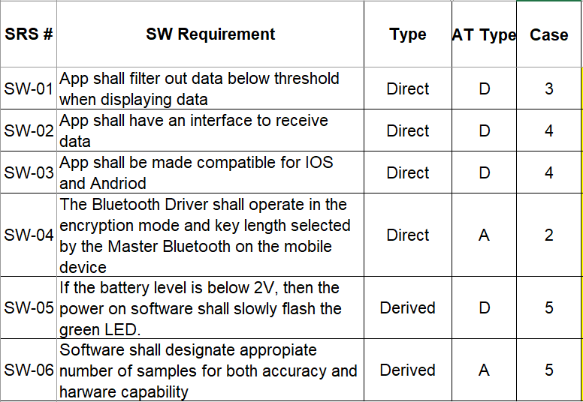
Identifying Software Requirements

Slide 17
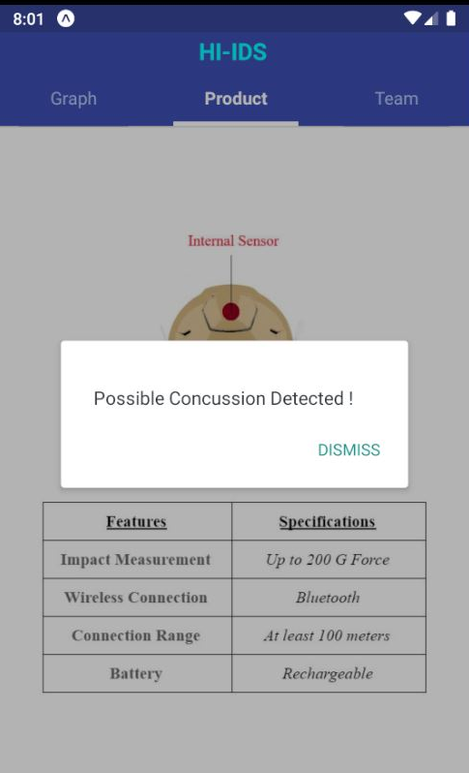
Software Design Details to Design HI-IDS Application
Navigation: Scrollable Tabs
User Interface is divided into multiple screens
Intro: project logo
History: dynamic graph
Product: helmet picture and features
Team: members’ information, role, and qualification
Main Functionalities:
Alert Box will pop up when data exceeds the threshold
Threshold: 100 G-Force
Graph will update based on the incoming data automatically

Slide 18
Concussions are a Serious Problem in Football !
Figure 1. NFL players making helmet on helmet contact.

Slide 19

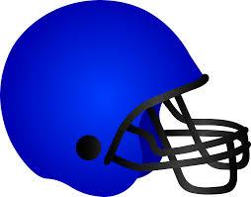


HI-IDS is Designed to Lower Brain
Damages in Players
Measures the g-force of collisions
Alerts coaches when a player is in danger of a concussion
Notes:
While at the same time … is durable and comfortable enough to be used like any regular football helmet
The software connect to the helmet will enable … to monitor…. And send alerts ..

Slide 20
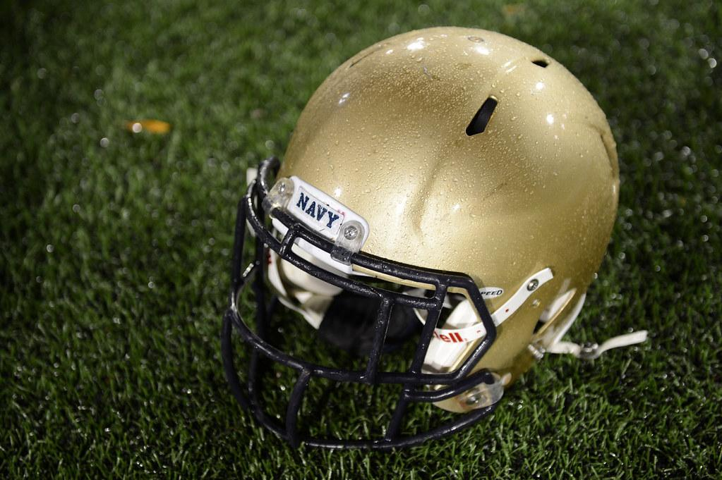
Questions?

